Slide 1
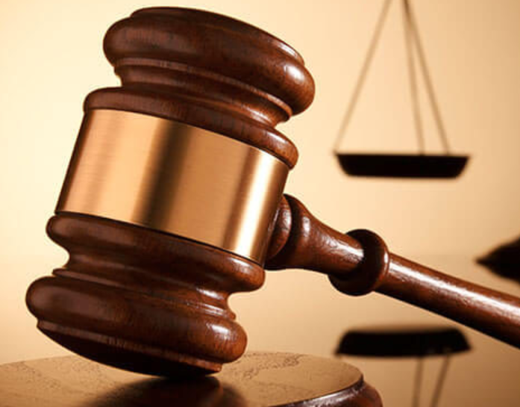

Smart Legal Assistant
.
Team members
Western Onzere
Nikita Samba
Catherine kiptui
Krystel Otieno
Noordin Hassan
Ryan Kuria

Slide 2

Prepared by Wordloom
Group Project
Smart Legal Assistant
15 April, 2025

Slide 3
Introduction
The Smart Legal Assistant is an AI-powered tool designed to streamline legal processes and provide accurate legal support for professionals and individuals.
Automates repetitive tasks
Provides real-time legal insights
Accessible 24/7

Slide 4
Data understanding
The Companies Act of Kenya 2015 governs company incorporation, registration, and management.. It allows single-member private companies, codifies directors’ duties, and enhances governance. Private companies must file financial statements within nine months and disclose beneficial ownership. The Act supports digital operations and virtual meetings, aligning with Vision 2030. Non-compliance incurs penalties, enforced by the Registrar of Companies.

Slide 5
Business Understanding
In this project we built smart legal assistant built with a deep understanding of the Companies Act of Kenya 2015totransform how businesses navigate legal compliance, governance, and operations. By offering proactive, technology-driven solutions, the assistant empowers clients to focus on growth while ensuring adherence to the Act’s requirements, ultimately contributing to Kenya’s business-friendly ecosystem.

Slide 6
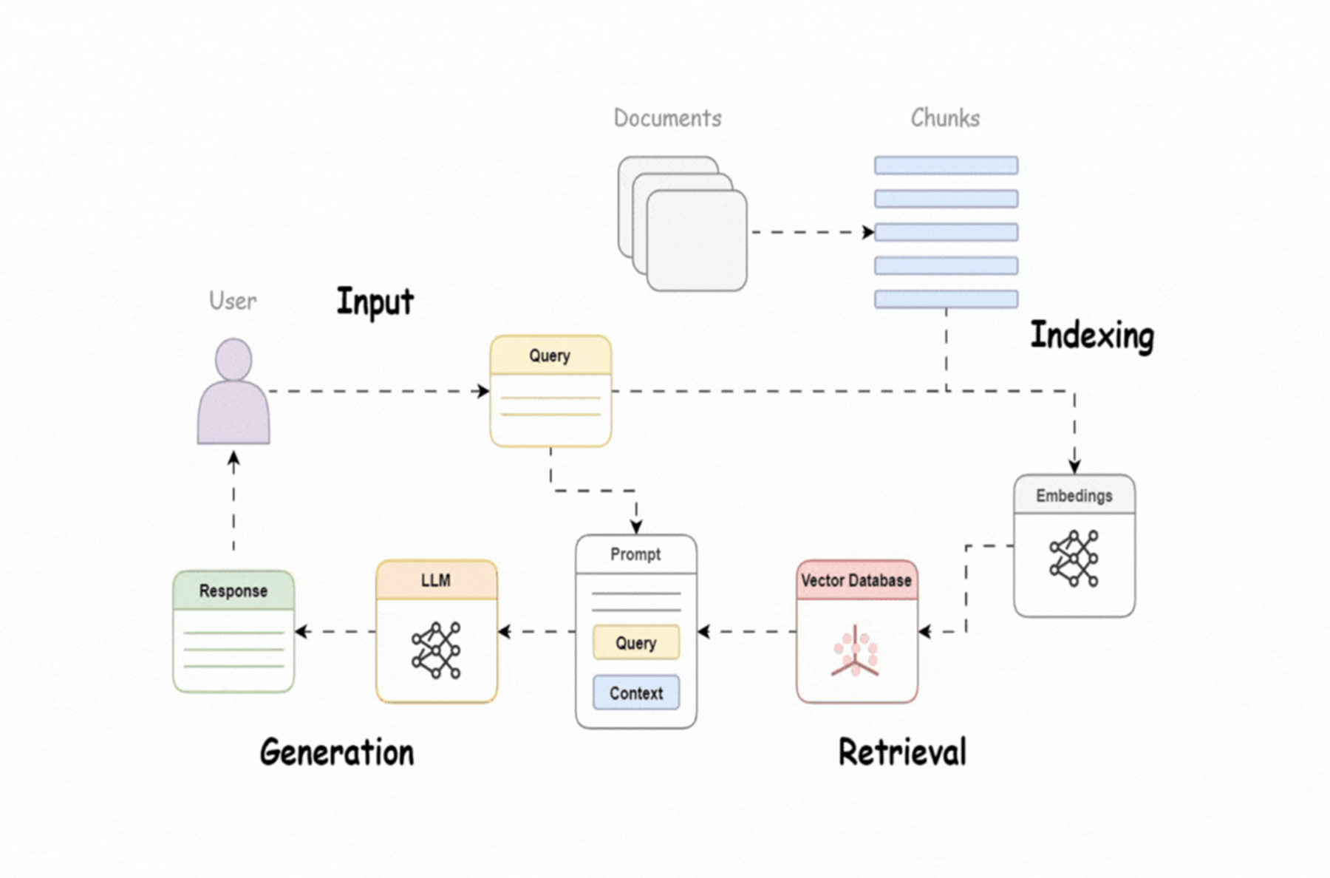
How it works

Slide 7



Work flow
Analysis Phase
Strategy Development
Assess internal legal workflows to identify repetitive tasks suitable for automation, such as contract review or compliance tracking..
Define clear objectives—e.g., reducing turnaround time or improving document consistency—and select the right AI tools aligned with data privacy laws..
Implementation Plan
Integrate the AI assistant into existing systems, train staff on usage, and set up monitoring to refine performance and ensure legal accuracy.
.

Slide 8

Project overview
Current legal Trends:
Rise in out-of-court settlements and mediation to avoid delays.
Market Insights:
Businesses are budgeting for ADR mechanisms to save time and cost..
Client Feedback:
Clients want clear litigation strategies and real-time updates on case progress.

Slide 9
Methodology
Data Collection:
Data sourcing
data curation.
Brainstorming Sessions:
Discussing the ideas with members.
Setting up project breakdown datelines.
Objectives.
Testing and Refinement:
Evaluating the tool accuracy and relevance.
Deployment.
Monitoring and evaluation.

Slide 10
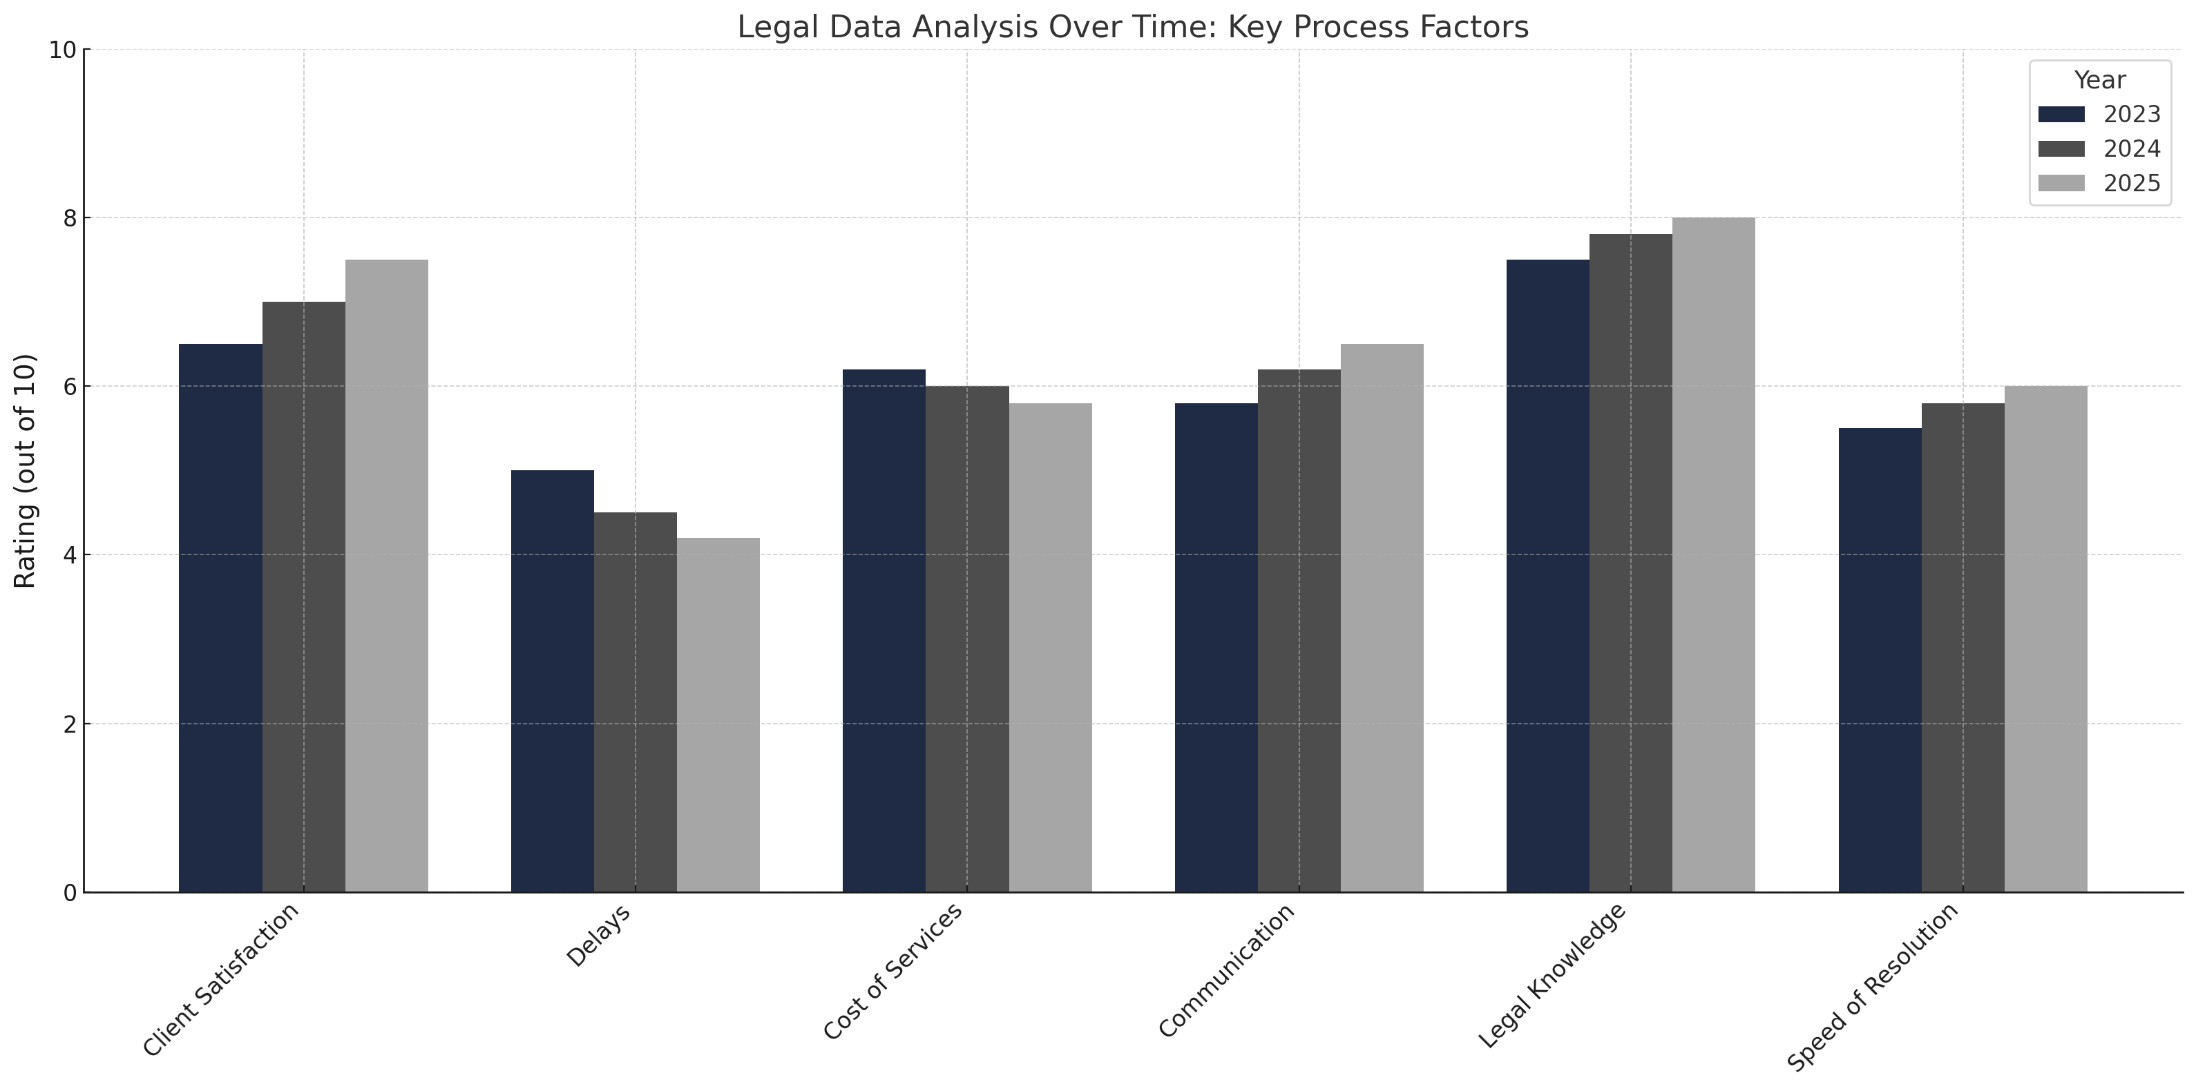

Slide 11

Expected Outcomes
Better Risk Management:
Real-time compliance alerts and automated policy tracking help minimize legal risks and regulatory breaches.
Cost Savings:
Reduction in billable hours and external legal consultancy fees by automating repetitive and low-risk legal processes..
Improved Accuracy & Consistency:
Standardized document drafting and reduced human error through AI-driven templates and legal content suggestions.

Slide 12
Conclusion
The smart legal assistant is able to answer queries keyed in by the user accurately .
The smart legal assistant removes the paperwork jargon by giving an answer by only a click away.
Legal queries obtain real time feedback on whether the companies act is being implemented or not.
.

Slide 13
Recommendations
We recommend the Smart Legal assistant to be used by companies to track adherence to the Kenyan companies act law to avoid hefty fines incase of drifting.
Global investors can also use the tool to vet which companies are legal and where to invest on.

Slide 14
Thank you

Slide 15
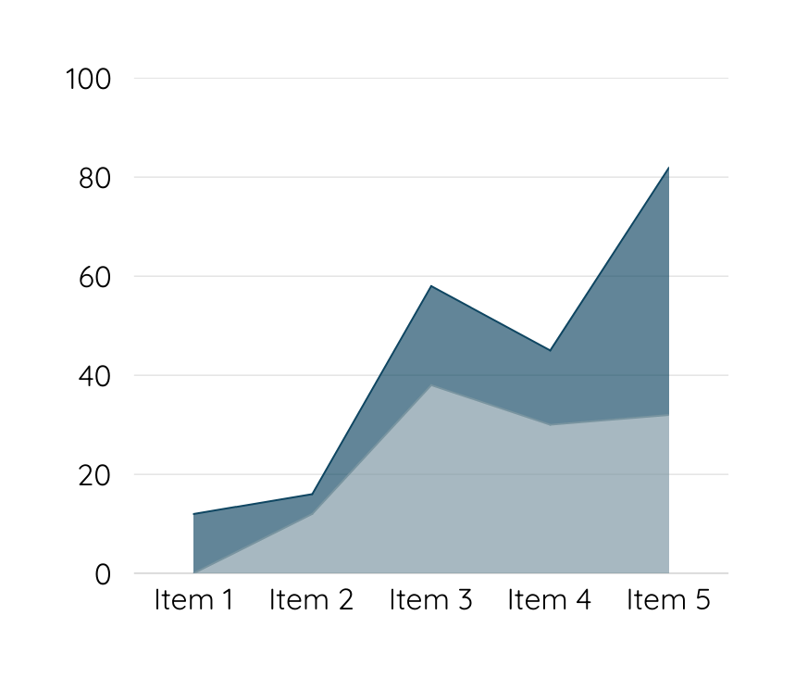
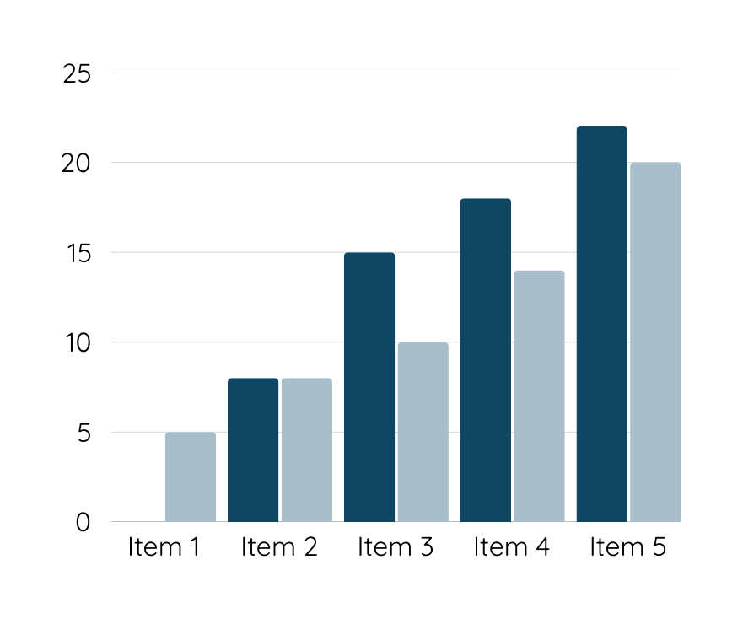
Data Analysis
Customers are unhappy with Warner & Spencer's new packaging, which may be contributing to a decline in sales. Competitors offer better features and pricing, making it difficult for our product to stand out in the market.

